Slide 1
Modern Web Technologies
Topic: Web Frameworks (Vue js).

Slide 2
What is Vue JS?
The name of the framework – Vue – is the same phonetically in English as view, and it corresponds to the traditional Model-View-Controller (MVC) architecture.
Vue is a JavaScript Framework for building Front-End UI`s (User Interface).
Simply put, view is a UI that the core library focuses on the view layer by default.

Slide 3
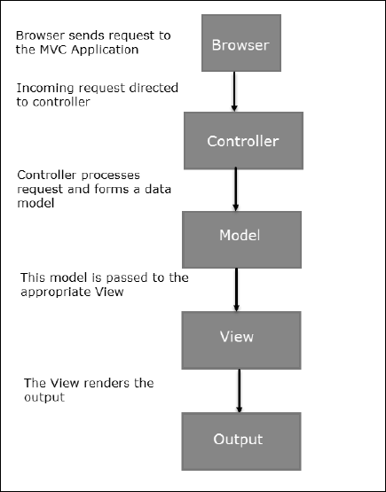
What is MVC(Model View Controller)?

Slide 4
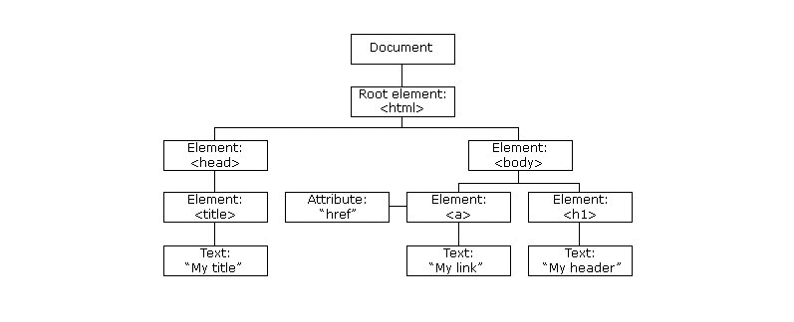
What is DOM(Document Object Model)?
A Document Object Model (DOM) is something we will probably encounter when rendering web pages.
A DOM is a representation of HTML pages with its styles, elements, and page content as objects.
The objects stored as a tree structure are generated by a browser when loading a page.
When a user interacts with the page, the objects change their state, so that a browser has to update the information and render it on the screen.

Slide 5
Why Vue JS?
Performance is one of the key factors that may predetermine any framework of our choice.
Vue.js utilizes virtual DOM: Think of this as a copy of an original DOM that figures out what elements to update, without re-rendering the whole DOM.
This approach makes page rendering pretty quick and improves application performance.
Vue.js seems to be more performant than Angular and React when testing DOM components bound with data updated, which factors in speed.

Slide 6
How to use Vue JS? (Demo)
To display our data within our HTML, we’ll first have to create a Vue app.
const app = Vue.createApp({})
As an argument, we’re going to pass in an object and add a data property. This is going to be a function that returns another object, where we’ll store our data. In here, we’ll add product as a data item.
const app = Vue.createApp({
data() {
return {
product: 'Socks'
}
}
})

Slide 7
const app = Vue.createApp({Options Object})
After creating a Vue app, we need to import and mount it to the DOM so that we can give our HTML a direct line into the app, this way the template code can access options from the app, such as data.
We Use “{{ }}” in Vue JS to write JavaScript Expressions like for ex:
<p>{{ firstName + ‘ ‘ + lastName }}</p> //Concatinating Strings
<span>{{ clicked ? True: false }}</span> //Conditional logic with a ternary operator
<div>{{ message.method() }}</div> //Methods
https://www.vuemastery.com/courses/intro-to-vue-3/creating-the-vue-app-vue3

Slide 8
Pros of Vue JS
Approachable.
Versatile and Scalability.
Performant.
Size.
Ease of Integration.
Easy Development.
Easy to Learn.
Reactive Two-Way Data Binding.
Component Reusability.
Code Readability.

Slide 9
Cons of Vue JS
Less Plugins/Components.
Deprecation is Fast.
Risk of over flexibility.
Limited Resources.

Slide 10
Resources :
https://v3.vuejs.org/guide/introduction.html#what-is-vue-js
https://v3.vuejs.org/style-guide/#rule-categories
https://v3.vuejs.org/cookbook/
https://v3.vuejs.org/examples/markdown.html

Slide 11

Thank You

